Slide 1
TOUR GUIDE FOR SPARTANS
By:
Chaya Malik
Minglei Lu
Yiming Zhai
Zening Deng

Slide 2
Our application aims to help Spartans discover the west coast of USA.
The difference between our application and an application like tripadvisor is that our app contains reviews by fellow spartans
This helps the people new to west coast of USA or california get easy reviews about how to visit places, enjoy amazing cuisines and still save some bucks
ABOUT OUR APPLICATION..

Slide 3
Architecture
FRONT END
HTML5
JADE CSS3
JavaScript
SERVER
NodeJS
ExpressJS
DATABASE
MongoDB

Slide 4
FRONT END
Why HTML5?
Cleaner Code
Smart Local Storage
Better Interactions
Legacy/Cross Browser Support
Why CSS?
Lightweight Code
Platform Independent
Cross Browser Compatible
Different Formatting Options
Why Jade?
Rapid Development
Reduces tedious markup as in case of HTML
Code Consistency
Why JavaScript
Input Validation
Speed
Simplicity
Lightweight, so fast request and response

Slide 5
SERVER SIDE TECHNOLOGIES
Why ExpressJS and NodeJS?
To set up middlewares to respond to HTTP requests
For routing requests
For dynamically rendering HTML pages
Session Management
Passport.js
Passport is authentication middleware for Node.
We use it to authenticate request from client side - be specific, the user login authentication.

Slide 6
DATABASE
Why MongoDB?
Schema less database
Powerful and deep query availability
Quick Iteration over data
Returns cursor instead of dataset on querying which improves performance.
Our MongoDB collections
User: to store user information
Places: to store information about places

Slide 7

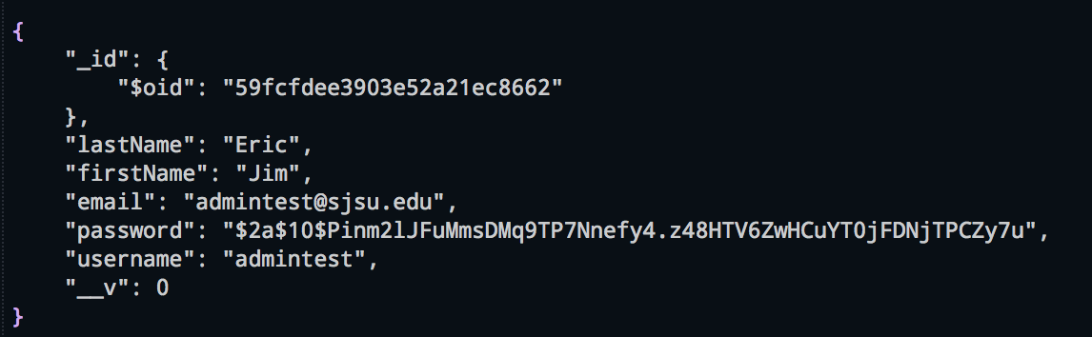
DATA SOURCES & STORAGE
We have stored our data online in mlab, which is a leading Database-as-a-service for MongoDB
There are two collections User and Places in our database.
The User collection is populated when a user interacts with the application, like signup, review a place using comments, etc.
The Places collection has been populated by us using the information available on internet and also using the inputs of users about a place.

Slide 8
LOOK & FEEL
GESTALT PRINCIPLES
UI DESIGN PATTERNS

Slide 9
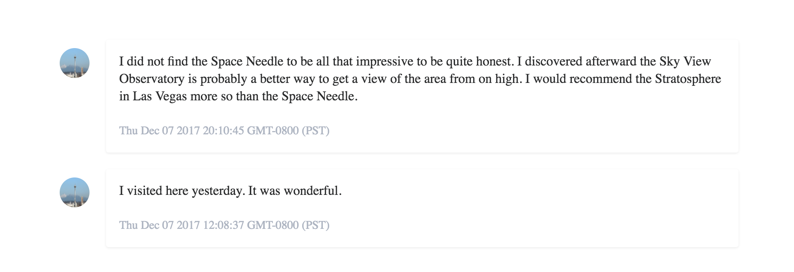
GESTALT PRINCIPLE:
“PROXIMITY”
Viewers will associate together items that are placed close together.
That’s why we put all our comments close to each other.

Slide 10
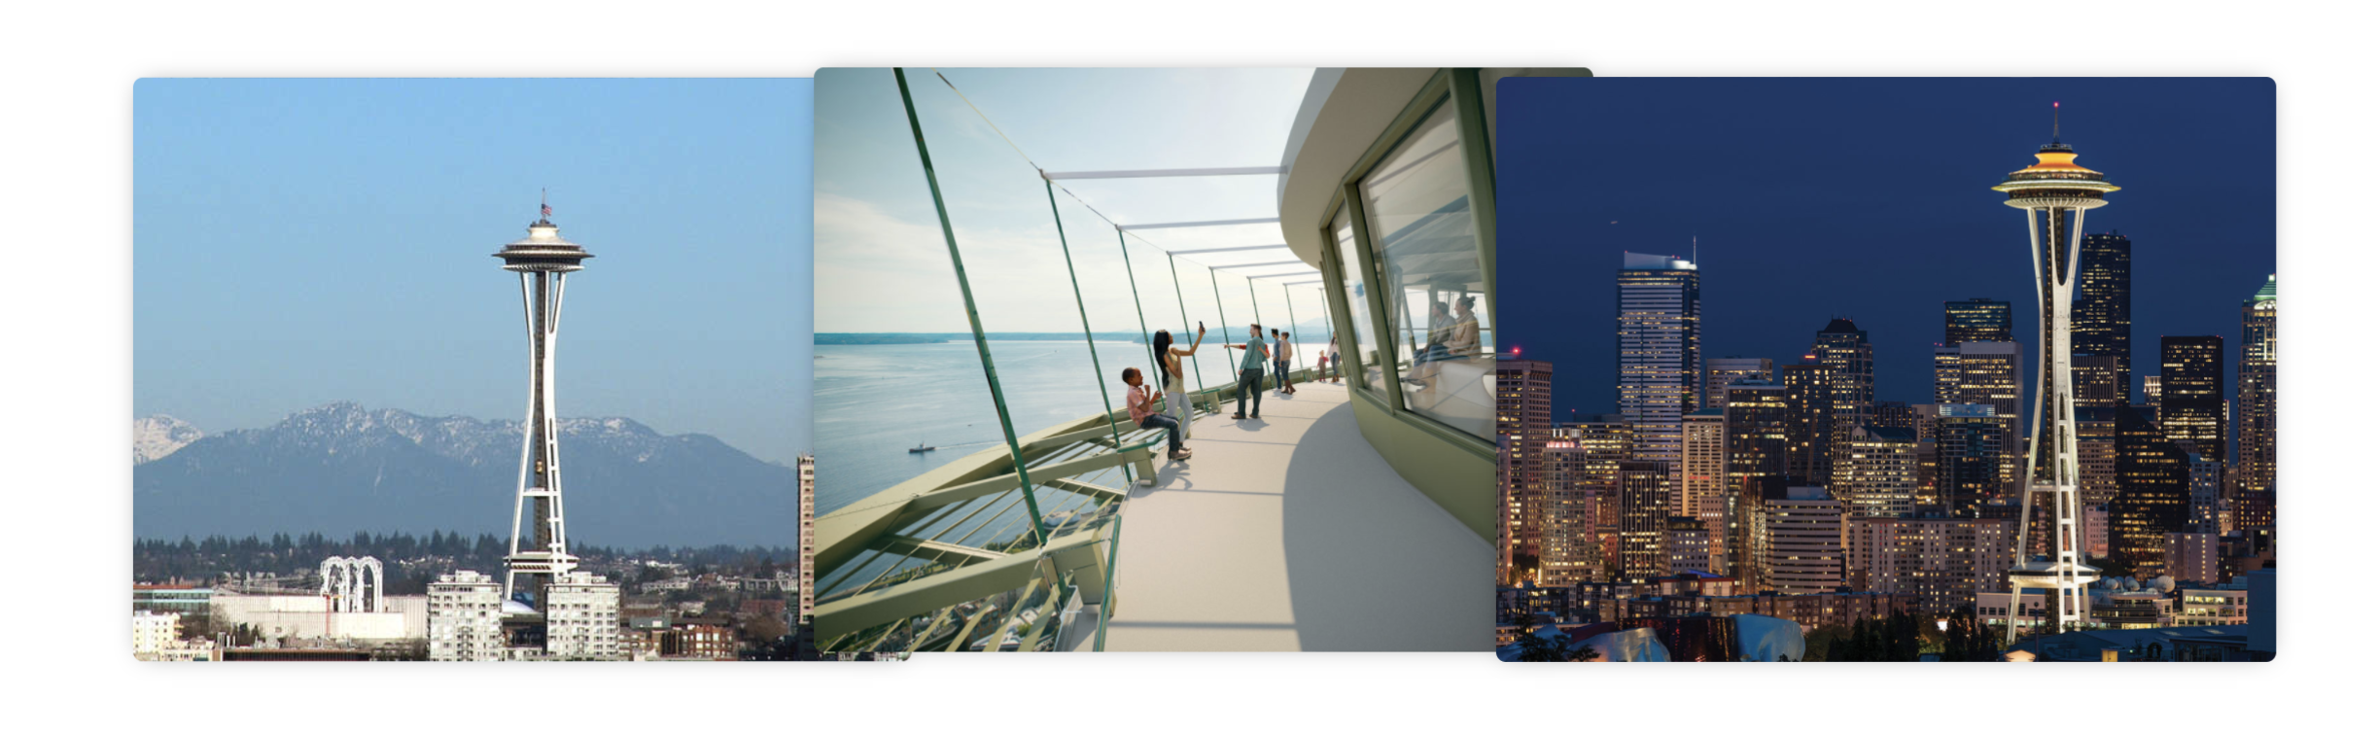
GESTALT PRINCIPLE:
“SIMILARITY”
Viewers will associate two things that have the same shape, size, orientation, etc.
We use a section that looks like a gallery to put our pictures together, in the same shape and size.

Slide 11
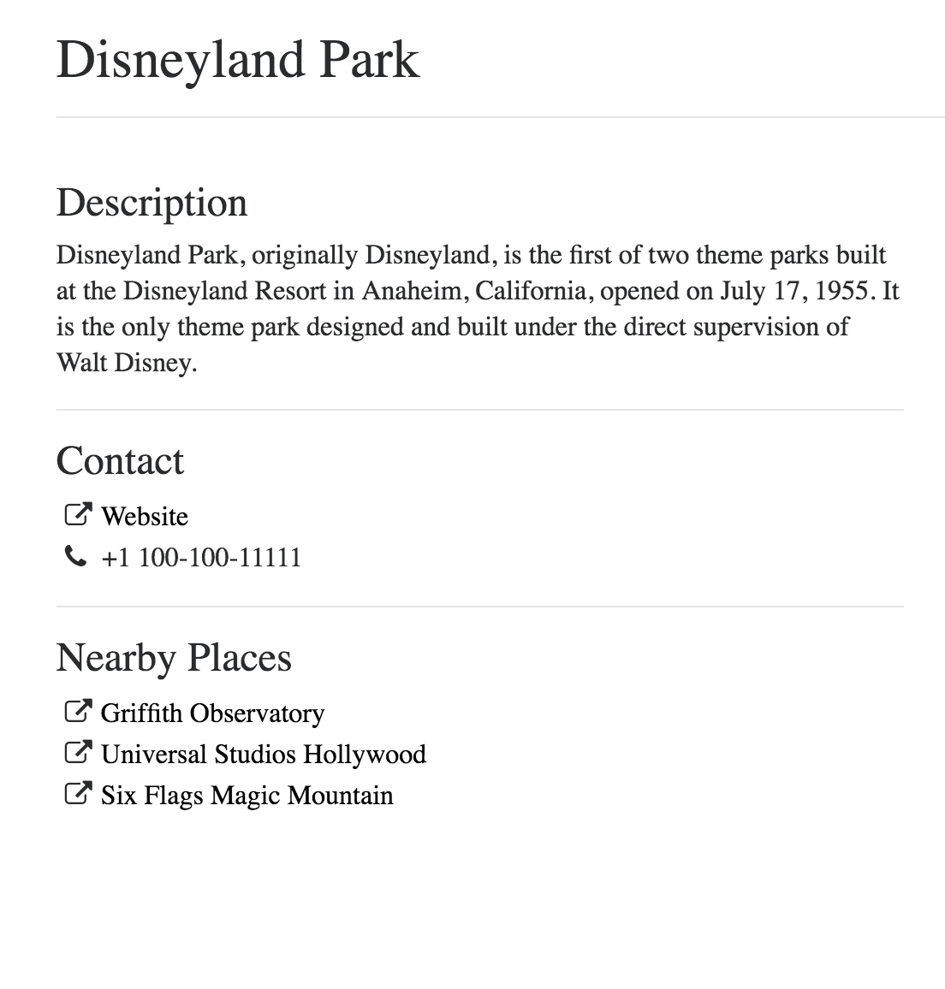
GESTALT PRINCIPLE:
“CONTINUITY”
Viewers’ eyes want to see continuous lines and curves formed by the alignment of items.
In our place display page, we use lines to separate and align different kind of information.

Slide 12
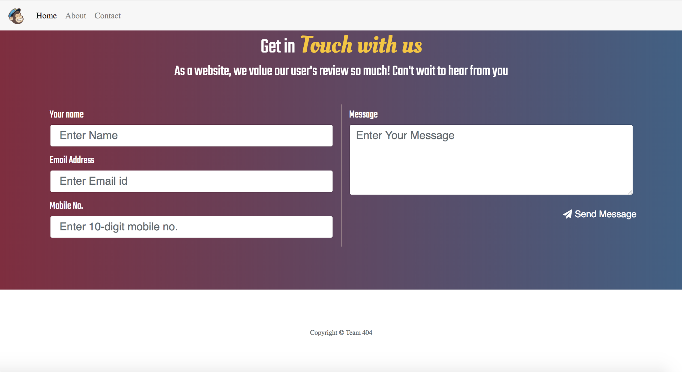
GESTALT PRINCIPLE:
“CLOSURE”
Viewers’ eyes want to see implicit simple closed forms such as rectangles.
We create a closed form for our contact page, makes the key attributes of page standing out.

Slide 13
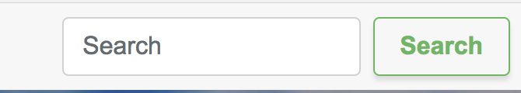
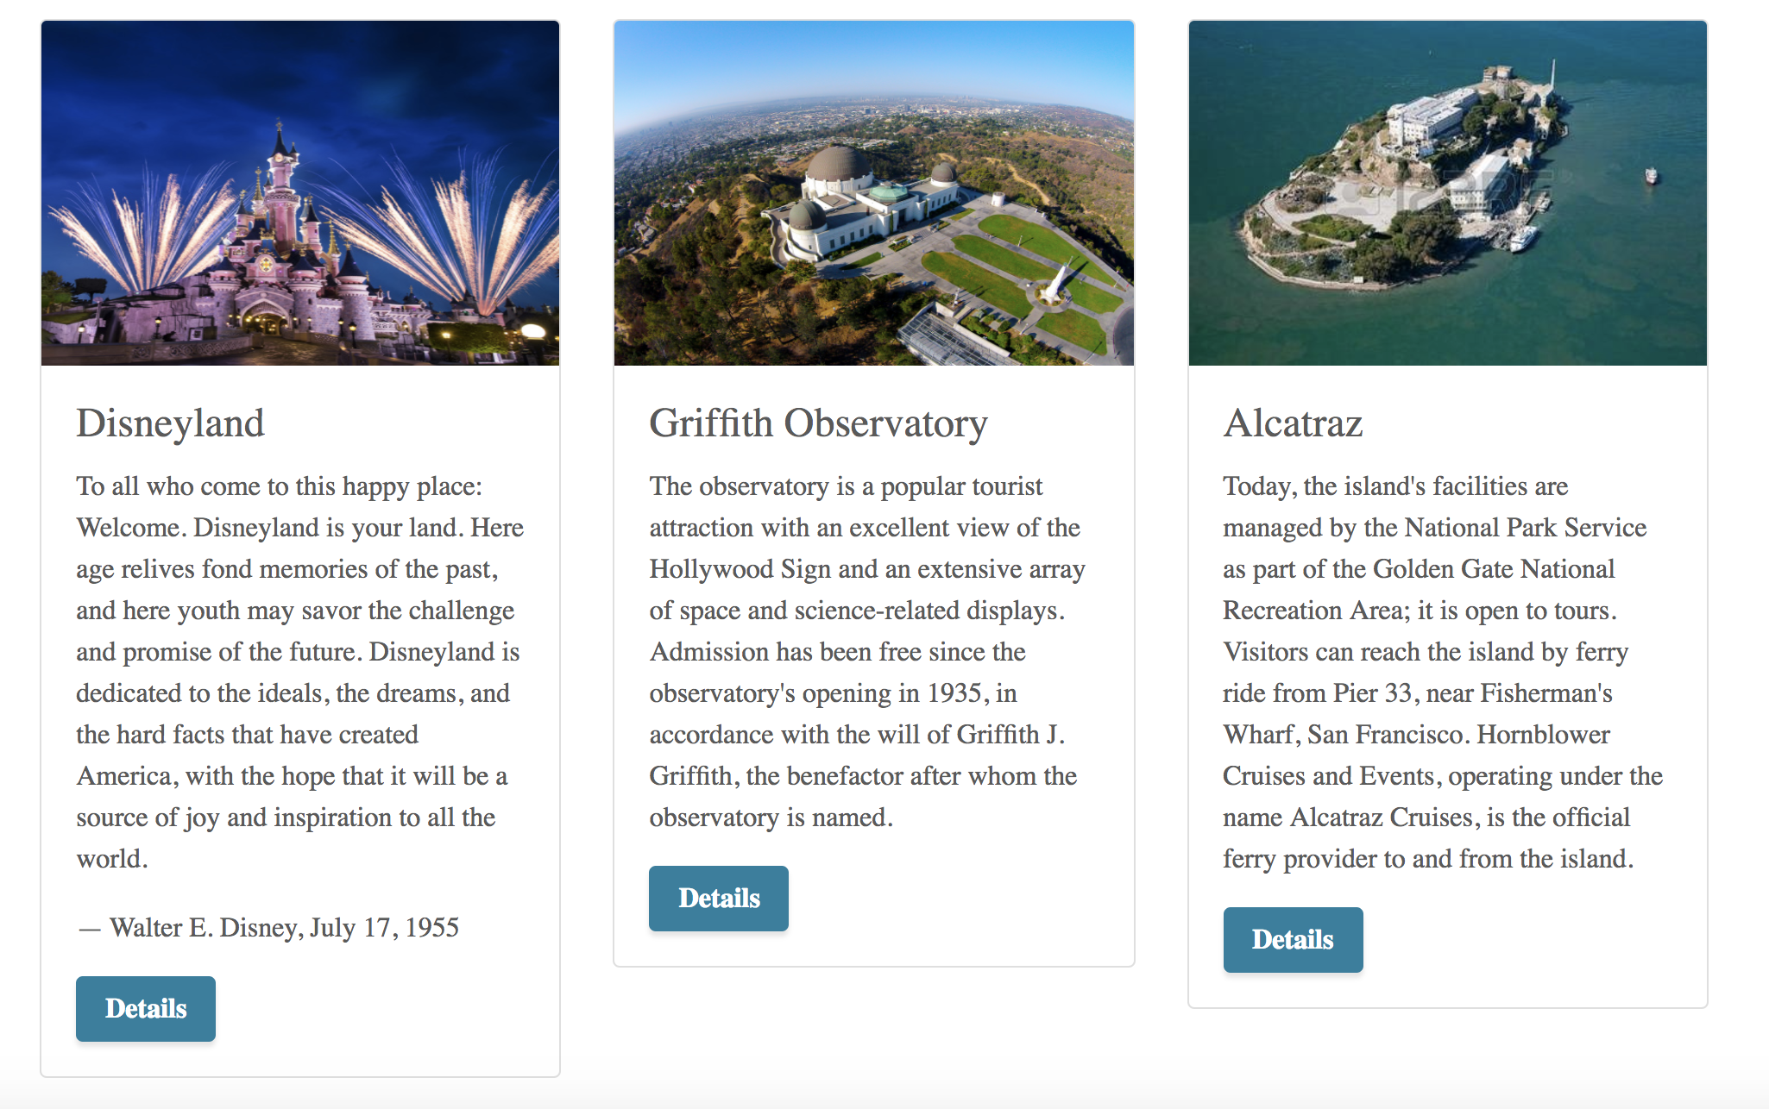
UI DESIGN PATTERN:
“Feature, Search and
Browse”
We use search bar for the search function
We also list featured items on the homepage to provide other options for the users.

Slide 14
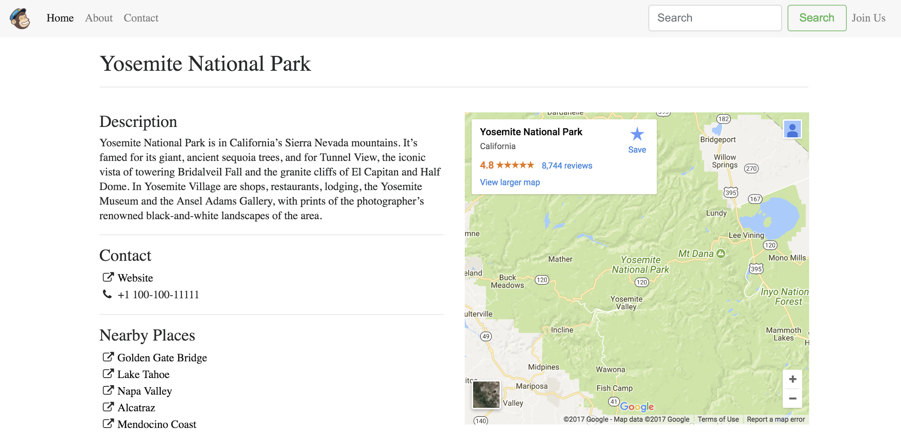
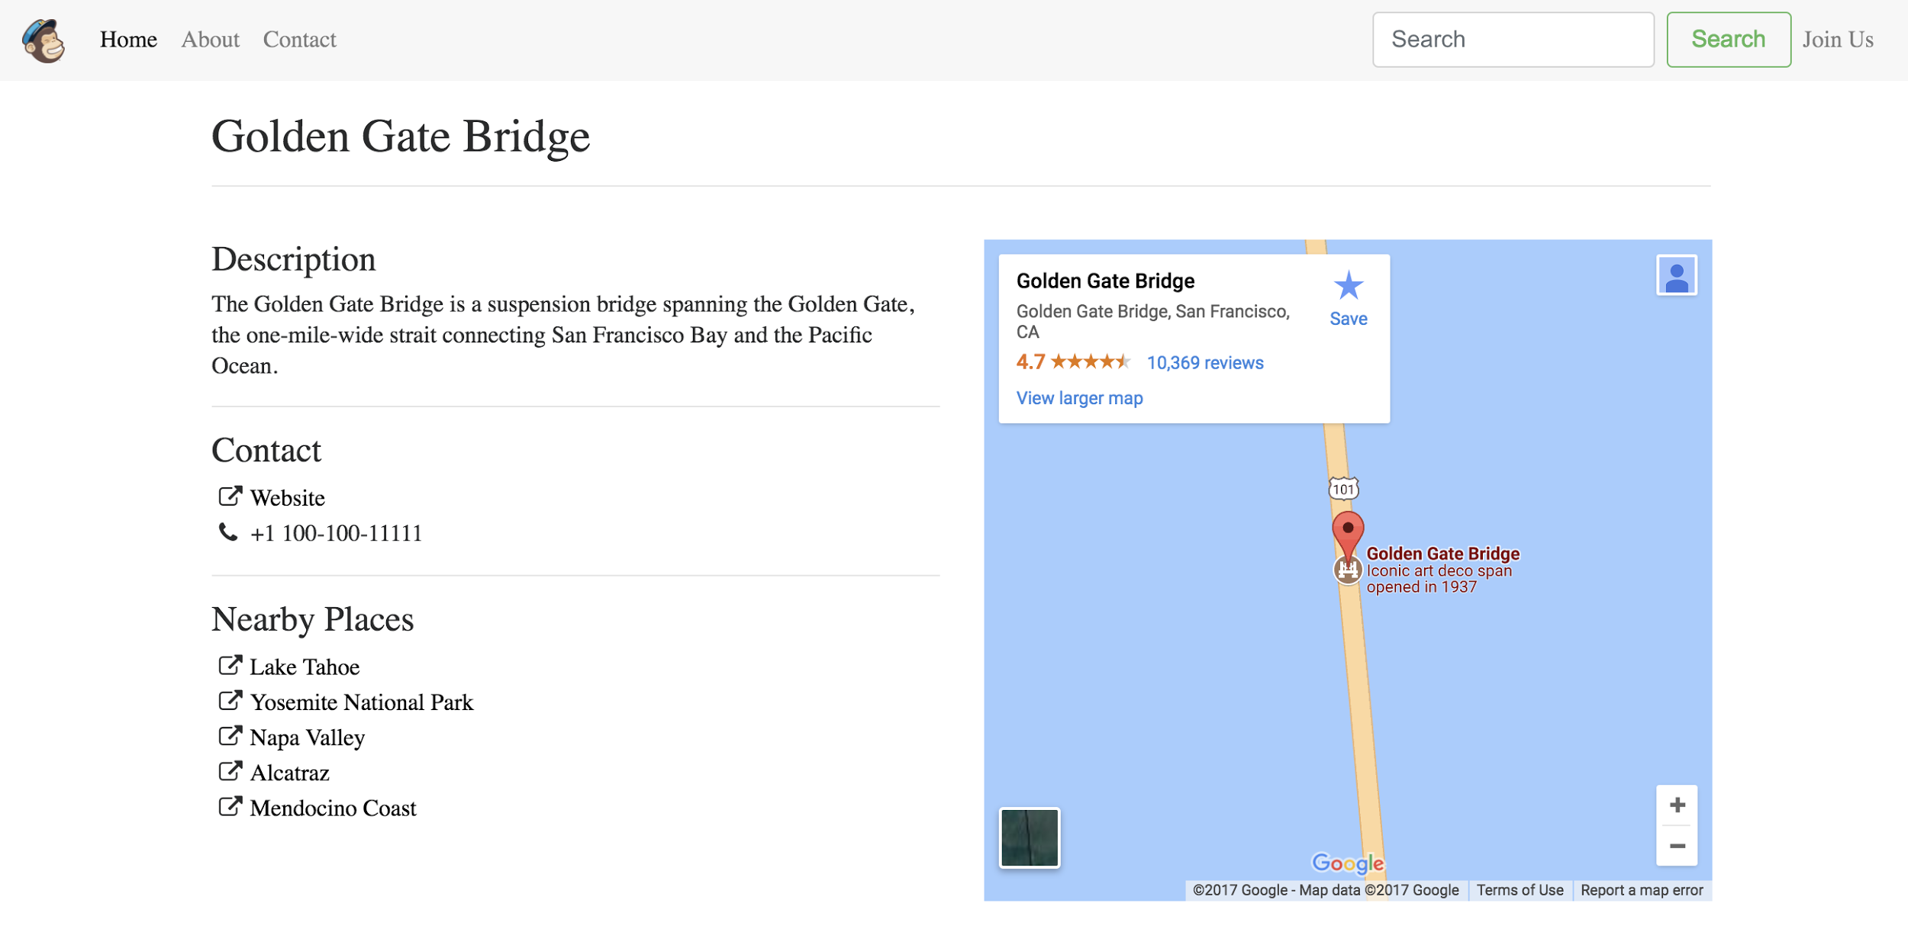
UI DESIGN PATTERN:
“Visual framework”
We use the same layout for the similar webpage, make it looks like they belong to each other.

Slide 15
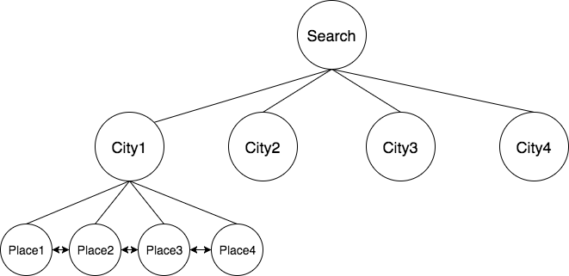
UI DESIGN PATTERN:
“MultiLevel”
We follow multilevel navigation design pattern.
The first level is search page.
Second is all the cities in our database.
Third is places which are connected to each other

Slide 16
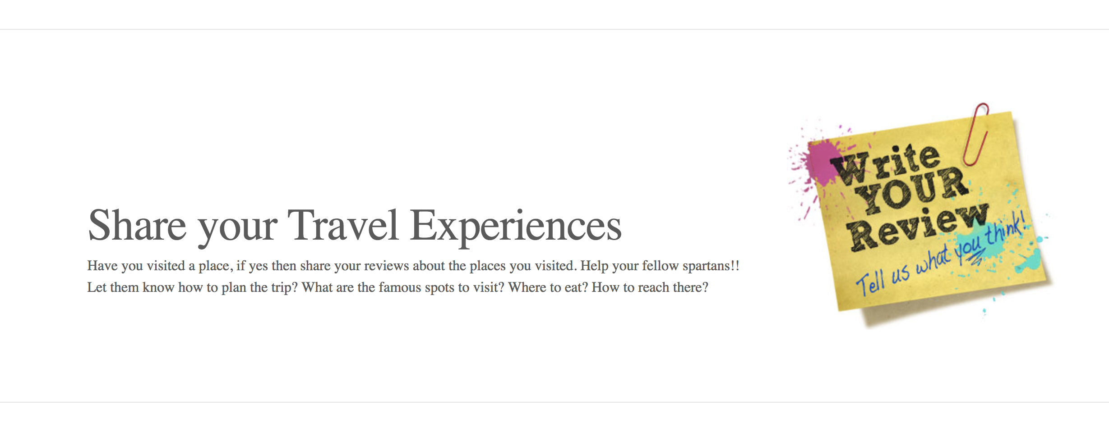
UI DESIGN PATTERN:
“Tiled Sections”
Tiled sections layout is visually separate section of content and each section has a strong title.
We implement such design pattern in our homepage to introduce our website’s basic function.

Slide 17
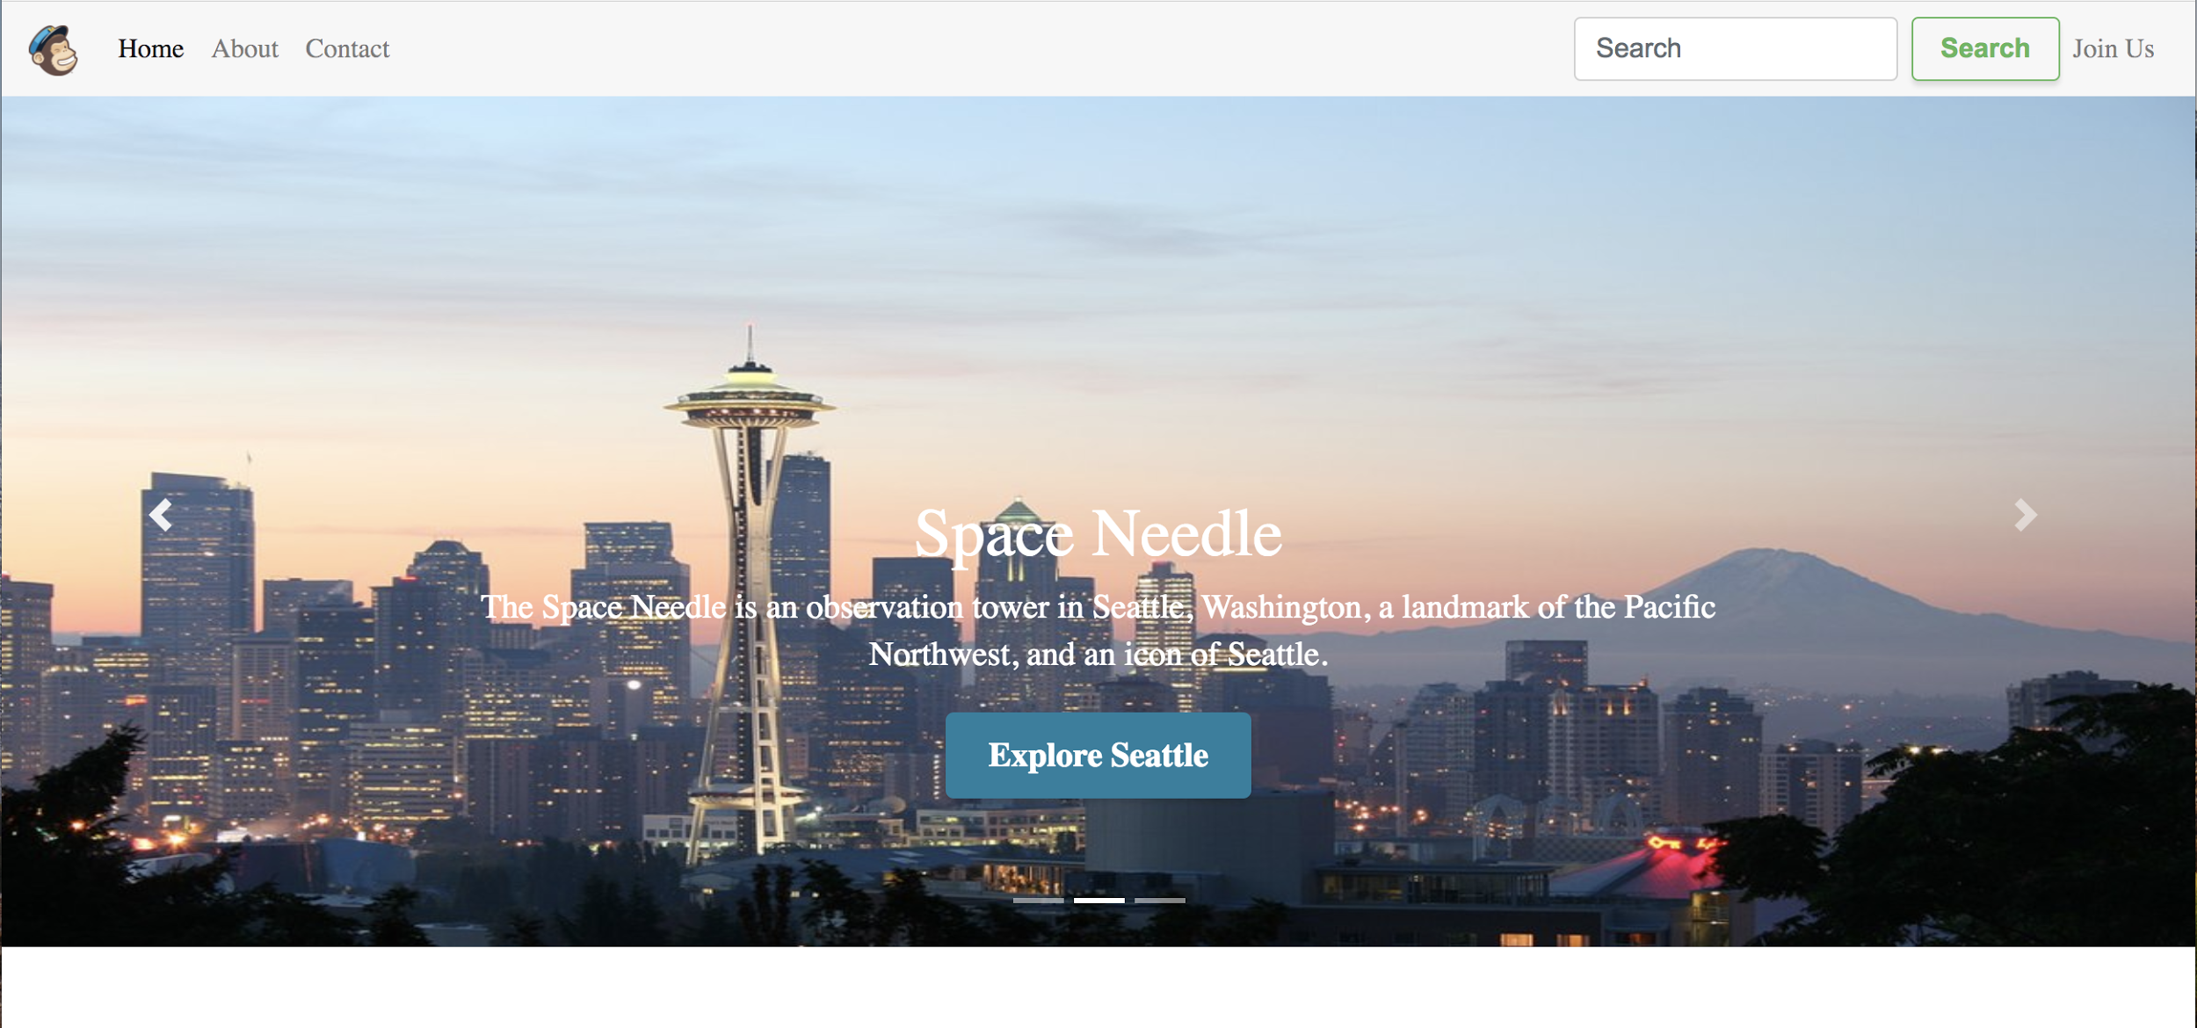
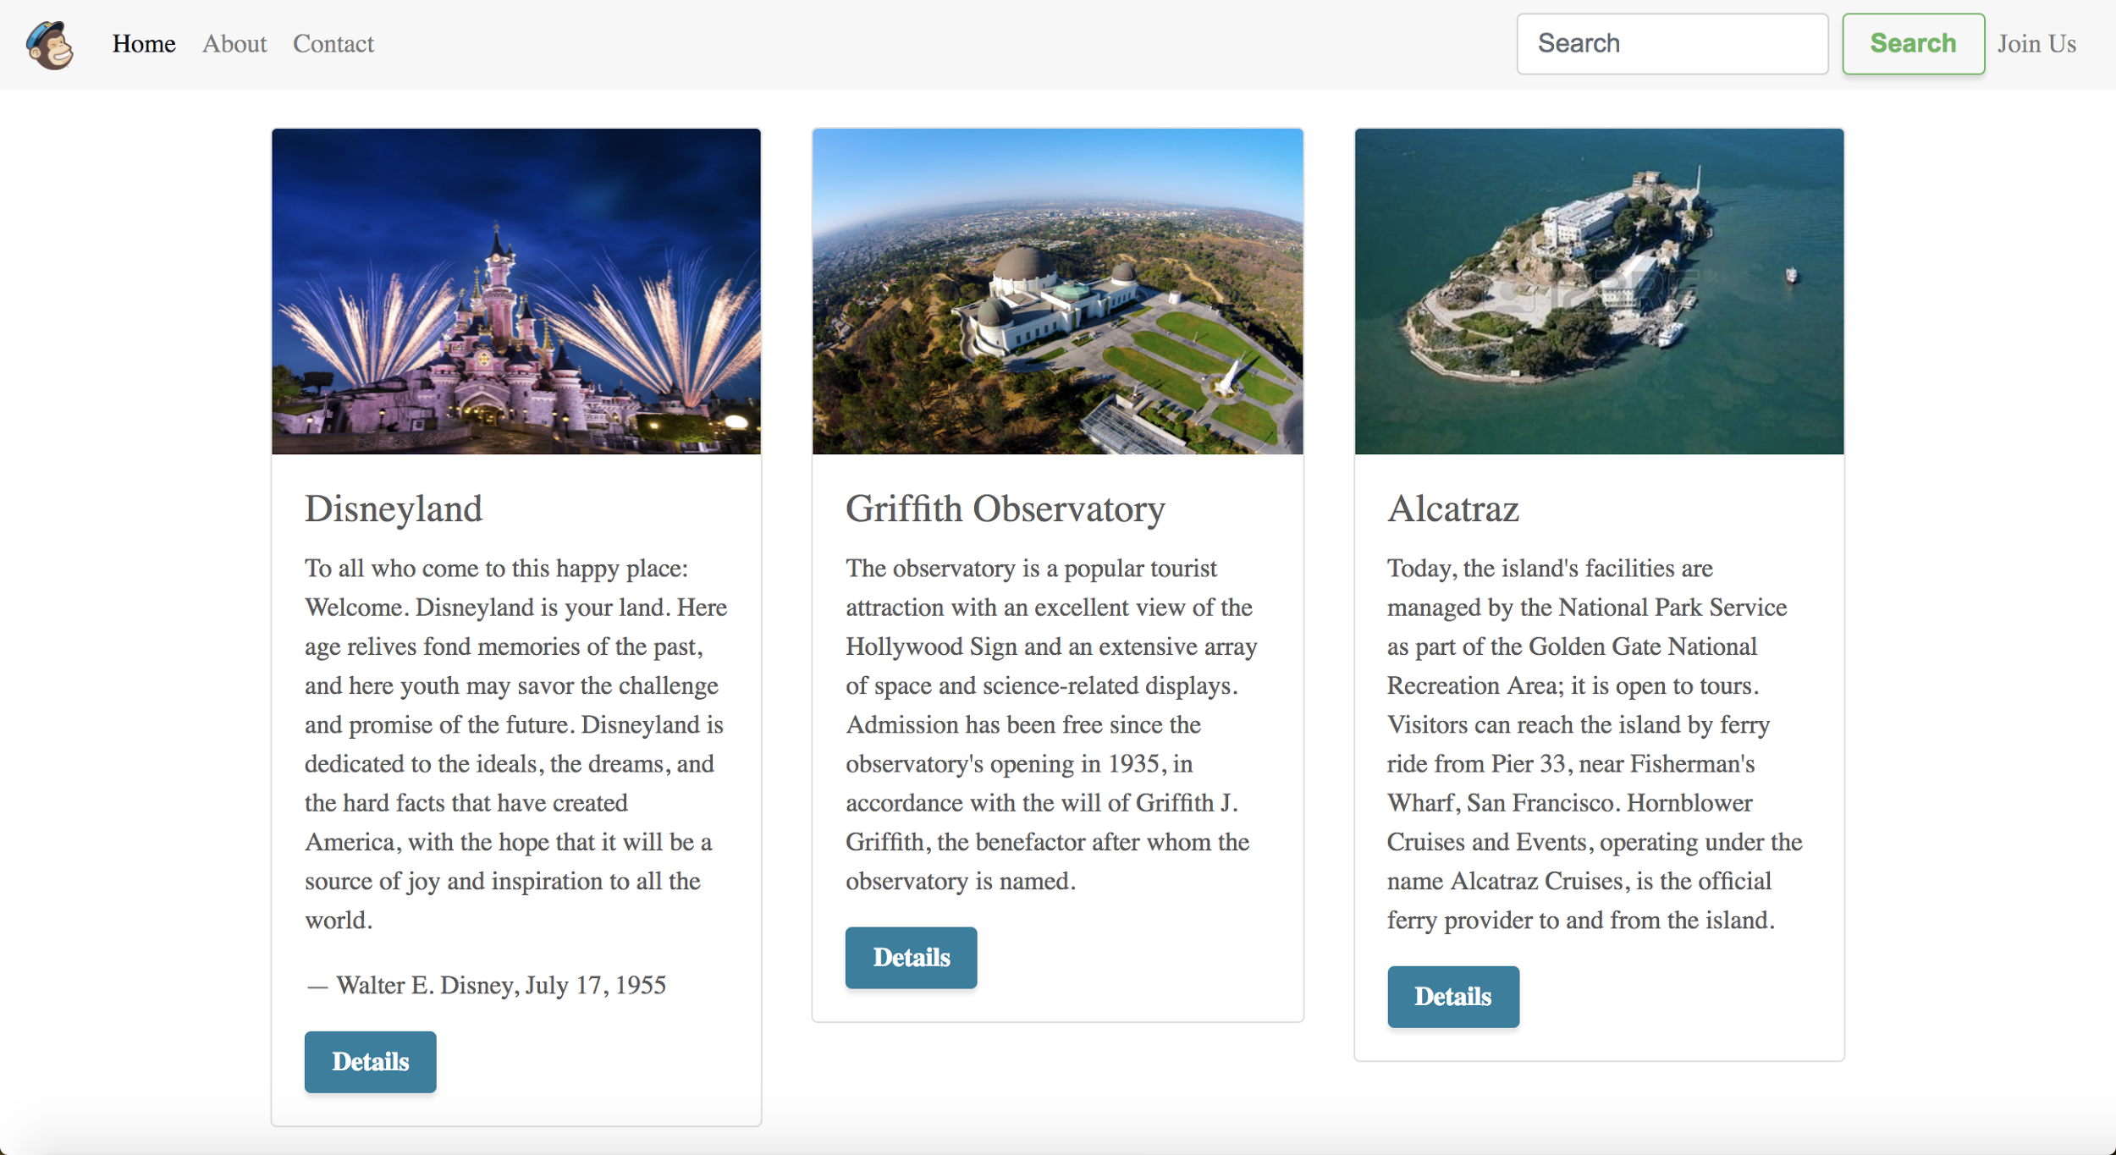
A glimpse of how our application looks

Slide 18


